Slide 1
Project on : Predicting Credit Card Acceptance
Group Members:
Mayukh Sen, 10200319014
Arka Dutta, 10200119015
Abhrajyoti Kundu, 10200219012
Sarthak Chatterjee, 10200119035
Arannyak Adhikari, 10200319035

Slide 2
Contents
Acknowledgement
Project Objective
Data Description
Data Analysis
Model Building
Analysis through Plots and Graphs

Slide 3
Acknowledgement
I take this opportunity to express my profound gratitude and deep regards to my faculty Titas Roy Chowdhury Sir, for his exemplary guidance, monitoring and constant encouragement throughout the course of this project. The blessing, help and guidance given by him/her time to time shall carry me a long way in the journey of life on which I am about to embark.
I am obliged to my project team members for the valuable information provided by them in their respective fields. I am grateful for their cooperation during the period of my assignment.

Slide 4
Project Objective
To predict whether a credit card application will be accepted based upon various data about the applicant.
Also to split into train and test data and create 4 different types of models from the data - Decision Trees, Linear Regression, Naive Bayes and K-NN
A small credit card dataset taken from : Kaggle, originally from William Greene's book Econometric Analysis

Slide 5
Data Description
card: Dummy variable, 1 if application for credit card accepted, 0 if not
reports: Number of major derogatory reports
age: Age n years plus twelfths of a year
income: Yearly income (divided by 10,000)
share: Ratio of monthly credit card expenditure to yearly income
expenditure: Average monthly credit card expenditure
owner: 1 if owns their home, 0 if rent
selfempl: 1 if self employed, 0 if not.
dependents: 1 + number of dependents
months: Months living at current address
majorcards: Number of major credit cards held
active: Number of active credit accounts

Slide 6
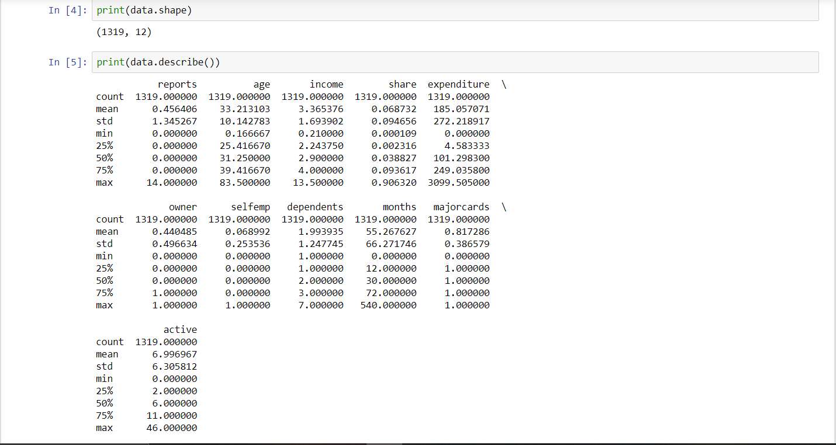
Data Analysis

Slide 7
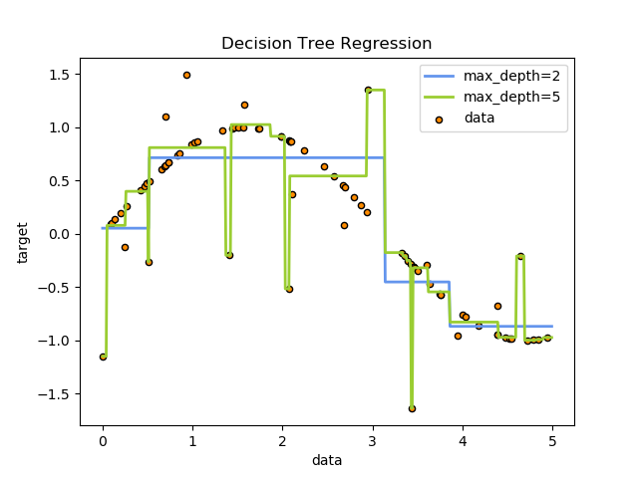
Model Building
Decision Trees:
Decision Trees (DTs) are a non-parametric supervised learning method used for classification and regression. The goal is to create a model that predicts the value of a target variable by learning simple decision rules inferred from the data features.
For instance, in the example below, decision trees learn from data to approximate a sine curve with a set of if-then-else decision rules. The deeper the tree, the more complex the decision rules and the fitter the model.

Slide 8
Some advantages of decision trees are:
Simple to understand and to interpret. Trees can be visualised.
Requires little data preparation. Other techniques often require data normalisation, dummy variables
need to be created and blank values to be removed
The cost of using the tree (i.e., predicting data) is logarithmic
in the number of data points used to train the tree.
Able to handle both numerical and categorical data. Other techniques are usually specialised in analyzing datasets that have only one type of variable.
Able to handle multi-output problems.
Uses a white box model. If a given situation is observable in a model, the explanation for the condition is easily
explained by boolean logic. By contrast, in a black box model (e.g., in an artificial neural network), results may be
more difficult to interpret.
Possible to validate a model using statistical tests. That makes it possible to account for the reliability of the model.
Performs well even if its assumptions are somewhat violated by the true model from which the data were generated.

Slide 9
The disadvantages of decision trees include:
Decision-tree learners can create over-complex trees that do not generalize the data well. This is called overfitting.
Mechanisms such as pruning (not currently supported), setting the minimum number of samples required at a leaf node or setting the maximum depth of the tree are necessary to avoid this problem.
Decision trees can be unstable because small variations in the data might result in a completely different tree being generated. This problem is mitigated by using decision trees within an ensemble.
The problem of learning an optimal decision tree is known to be NP-complete under several aspects of optimality and even for simple concepts. Consequently, practical decision-tree learning algorithms are based on heuristic algorithms such as the greedy algorithm where locally optimal decisions are made at each node. Such algorithms cannot guarantee to return the globally optimal decision tree. This can be mitigated by training multiple trees in an ensemble
learner, where the features and samples are randomly sampled with replacement.
There are concepts that are hard to learn because decision trees do not express them easily, such as XOR, parity or multiplexer problems.
Decision tree learners create biased trees if some classes dominate. It is therefore recommended to balance the dataset prior to fitting with the decision tree.

Slide 10
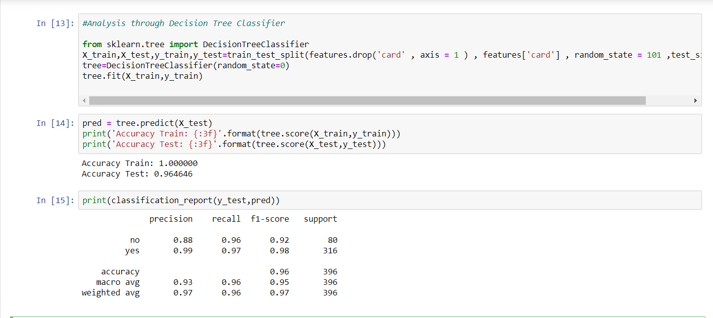

Slide 11
Linear Regression:
class sklearn.linear_model.LinearRegression(fit_intercept=True, normalize=False, copy_X=True, n_jobs=None)
Ordinary least squares Linear Regression.
Linear Regression fits a linear model with coefficients w = (w1, …, wp) to minimize the residual sum of squares
between the observed targets in the dataset, and the targets predicted by the linear approximation.
Methods : -
fit(self, X, y[, sample_weight]) | Fit linear model.
get_params(self[, deep]) | Get parameters for this estimator.
predict(self, X) | Predict using the linear model.
score(self, X, y[, sample_weight]) | Return the coefficient of determination R^2 of the prediction.
set_params(self, \*\*params) | Set the parameters of this estimator.

Slide 12
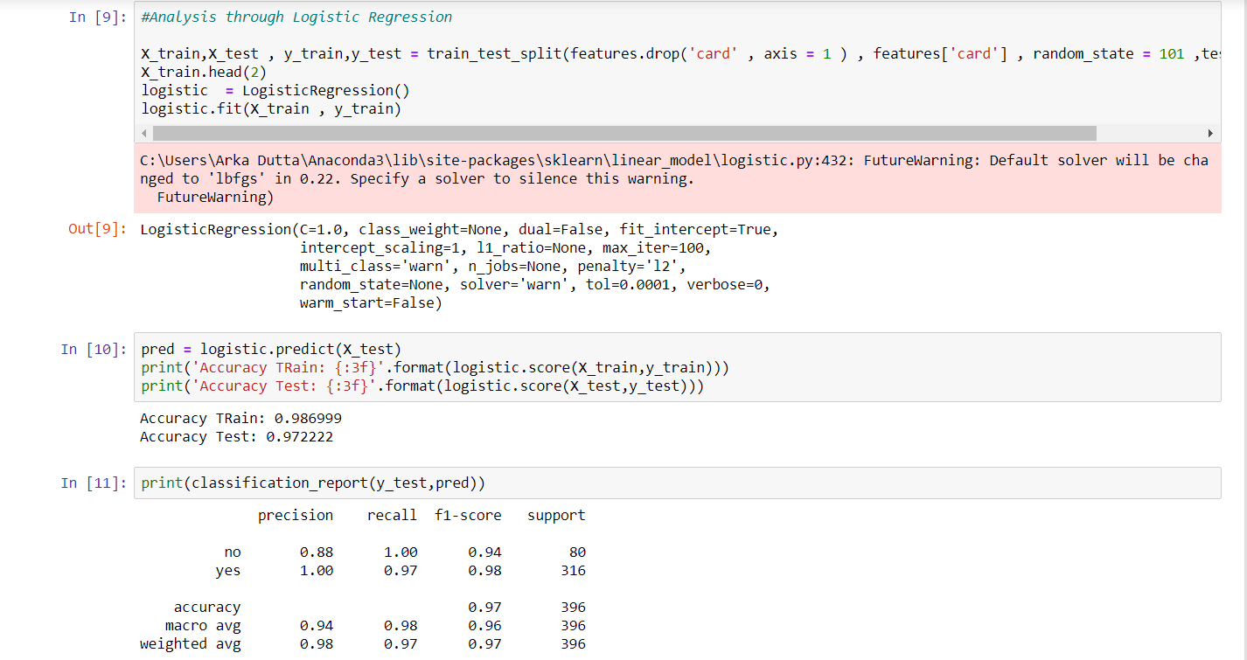

Slide 13
Naive Bayes:
Naive Bayes methods are a set of supervised learning algorithms based on applying Bayes’ theorem with the “naive” assumption of
conditional independence between every pair of features given the value of the class variable.
Bayes’ theorem states the following relationship, given class variable y and dependent feature vector x1 through xn, :
P(y∣x1,…,xn)=P(y)P(x1,…xn∣y)P(x1,…,xn)
Using the naive conditional independence assumption that
P(xi|y,x1,…,xi−1,xi+1,…,xn)=P(xi|y),
for all i, this relationship is simplified to
P(y∣x1,…,xn)=P(y)∏i=1nP(xi∣y)P(x1,…,xn)
Since P(x1,…,xn) is constant given the input, we can use the following classification rule:
P(y∣x1,…,xn)∝P(y)∏i=1nP(xi∣y)⇓y^=arg⁡maxyP(y)∏i=1nP(xi∣y),
Naive Bayes learners and classifiers can be extremely fast compared to more sophisticated methods.
The decoupling of the class conditional feature distributions means that each distribution can be independently estimated as a one
dimensional distribution. This in turn helps to alleviate problems stemming from the curse of dimensionality.
On the flip side, although naive Bayes is known as a decent classifier, it is known to be a bad estimator, so the probability outputs from
predict_proba are not to be taken too seriously.

Slide 14
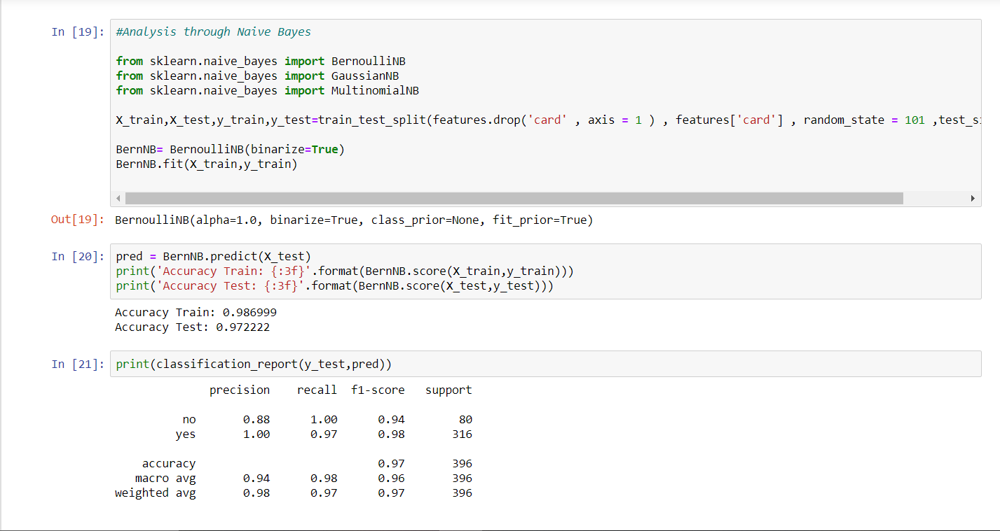
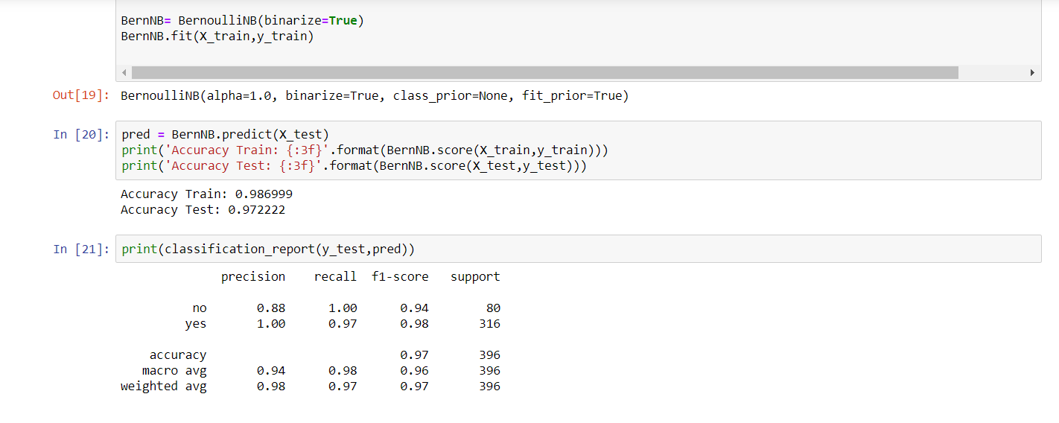

Slide 15
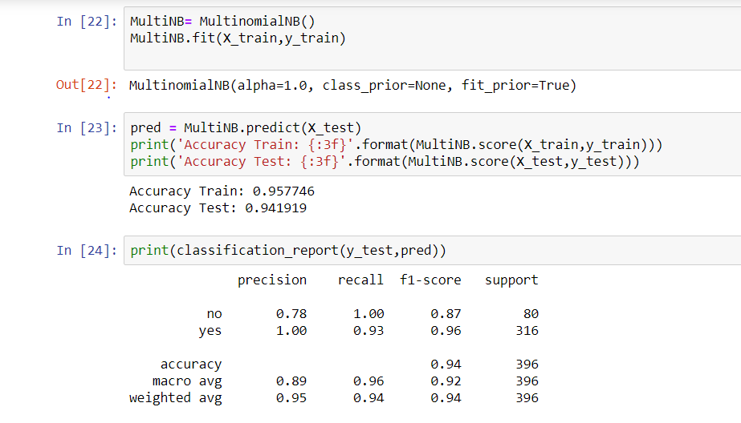

Slide 16
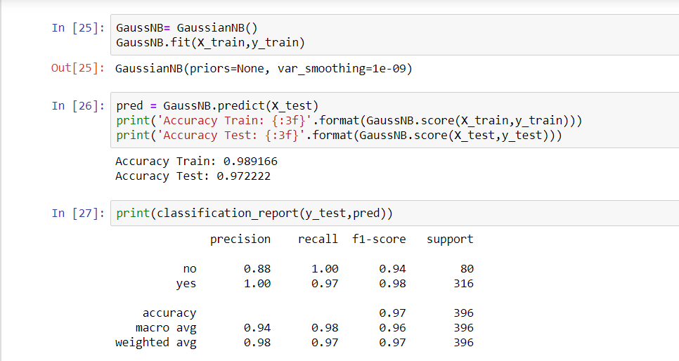

Slide 17
K-Nearest Neighbour:
KNN (K-Nearest Neighbor) is a simple supervised classification algorithm we can use to assign a class to new data point. It can be used for regression as well, KNN does not make any assumptions on the data distribution, hence it is non-parametric. It keeps all the training data to make future predictions by computing the similarity between an input sample and each training instance.
KNN can be summarized as below:
Computes the distance between the new data point with every training example.
For computing the distance measures such as Euclidean distance, Hamming distance or Manhattan distance will be used.
Model picks K entries in the database which are closest to the new data point.
Then it does the majority vote i.e the most common class/label among those K entries will be the class of the new data point.

Slide 18
Parameters
n_neighborsint, optional (default = 5)
Number of neighbors to use by default for kneighbors queries.
weightsstr or callable, optional (default = ‘uniform’)
weight function used in prediction. Possible values:
‘uniform’ : uniform weights. All points in each neighborhood are weighted equally.
‘distance’ : weight points by the inverse of their distance. in this case, closer neighbors of a query point will have a greater influence than neighbors which are further away.
[callable] : a user-defined function which accepts an array of distances, and returns an array of the same shape containing the weights.
algorithm{‘auto’, ‘ball_tree’, ‘kd_tree’, ‘brute’}, optional
Algorithm used to compute the nearest neighbors:
‘ball_tree’ will use BallTree
‘kd_tree’ will use KDTree
‘brute’ will use a brute-force search.
‘auto’ will attempt to decide the most appropriate algorithm based on the values passed to fit method.
Note: fitting on sparse input will override the setting of this parameter, using brute force.
leaf_sizeint, optional (default = 30)
Leaf size passed to BallTree or KDTree. This can affect the speed of the construction and query, as well as the memory required to store the tree. The optimal value depends on the nature of the problem.
pinteger, optional (default = 2)
Power parameter for the Minkowski metric. When p = 1, this is equivalent to using manhattan_distance (l1), and euclidean_distance (l2) for p = 2. For arbitrary p, minkowski_distance (l_p) is used.

Slide 19
metricstring or callable, default ‘minkowski’
the distance metric to use for the tree. The default metric is minkowski, and with p=2 is equivalent to the standard Euclidean metric. See the documentation of the DistanceMetric class for a list of available metrics. If metric is “precomputed”, X is assumed to be a distance matrix and must be square during fit. X may be a Glossary, in which case only “nonzero” elements may be considered neighbors.
metric_paramsdict, optional (default = None)
Additional keyword arguments for the metric function.
n_jobsint or None, optional (default=None)
The number of parallel jobs to run for neighbors search. None means 1 unless in a joblib.parallel_backend context. -1 means using all processors. See Glossary for more details. Doesn’t affect fit method.
Attributes
classes_array of shape (n_classes,)
Class labels known to the classifier
effective_metric_string or callble
The distance metric used. It will be same as the metric parameter or a synonym of it, e.g. ‘euclidean’ if the metric parameter set to ‘minkowski’ and p parameter set to 2.
effective_metric_params_dict
Additional keyword arguments for the metric function. For most metrics will be same with metric_params parameter, but may also contain the p parameter value if the effective_metric_ attribute is set to ‘minkowski’.
outputs_2d_bool
False when y’s shape is (n_samples, ) or (n_samples, 1) during fit otherwise True.

Slide 20
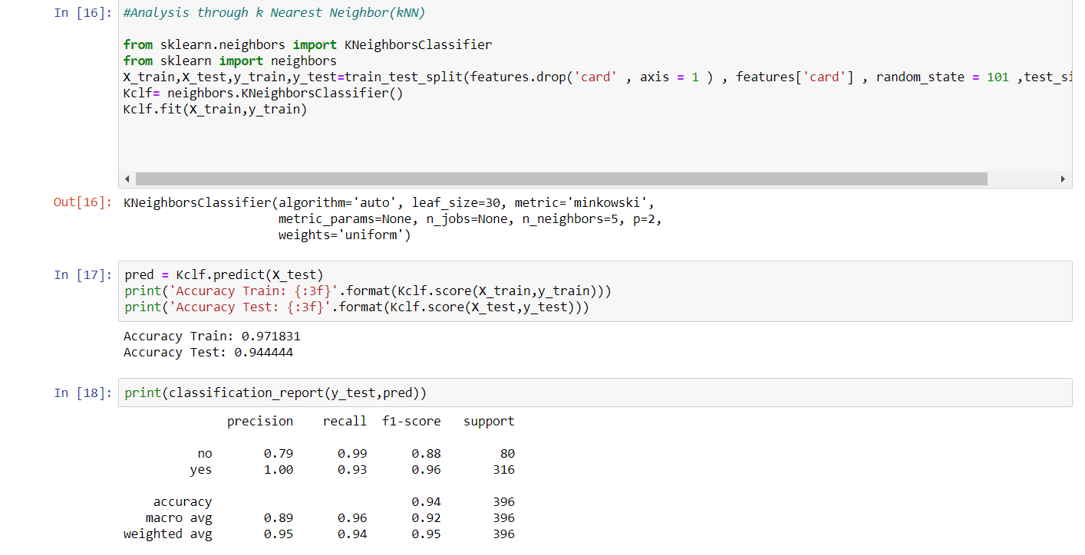

Slide 21
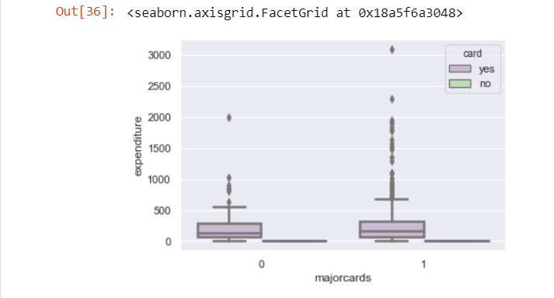
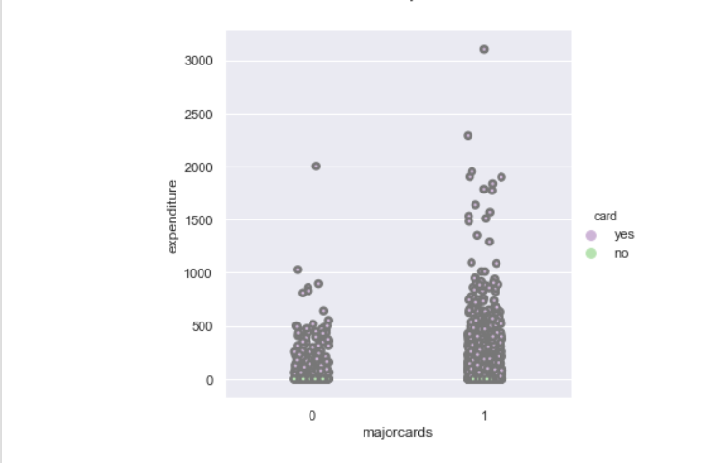
Analysis through plots and graphs
Box Plot
Cat Plot

Slide 22
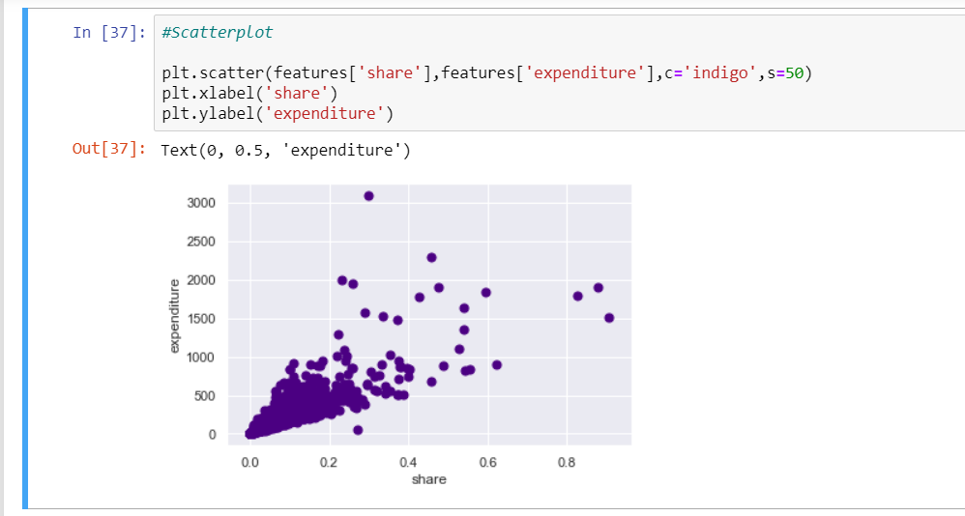

Slide 23
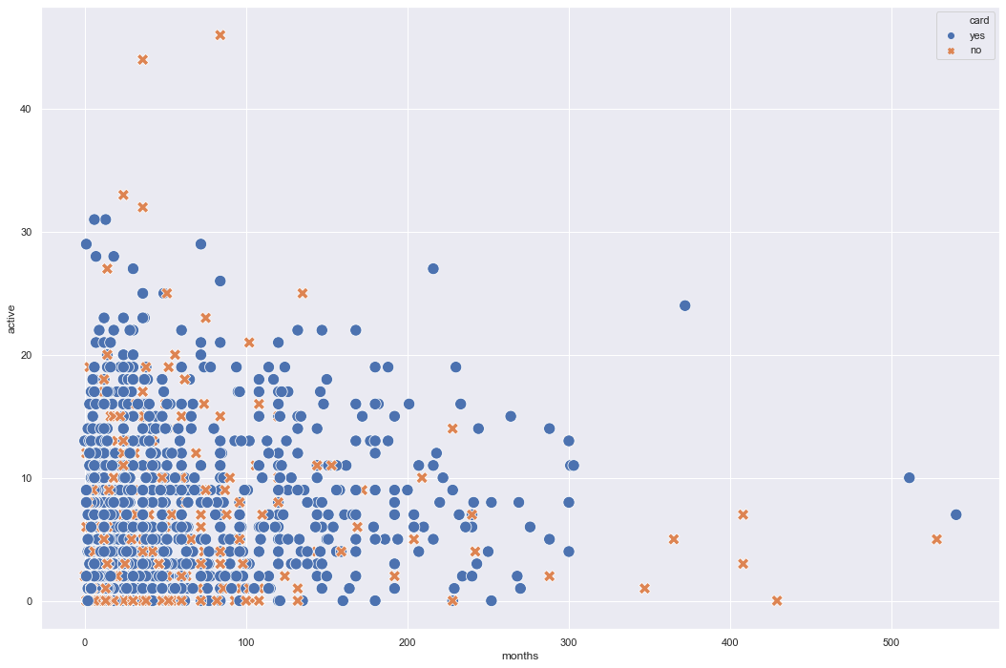

Slide 24
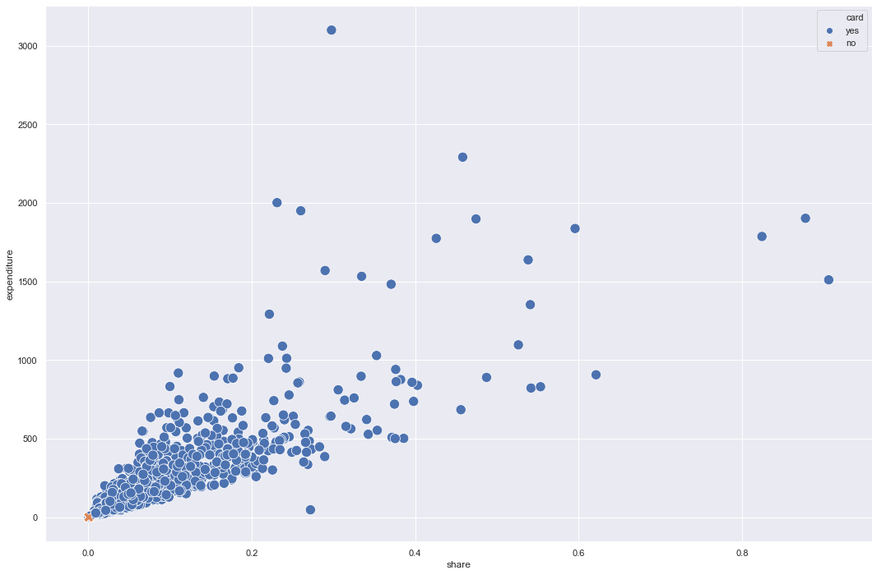

Slide 25

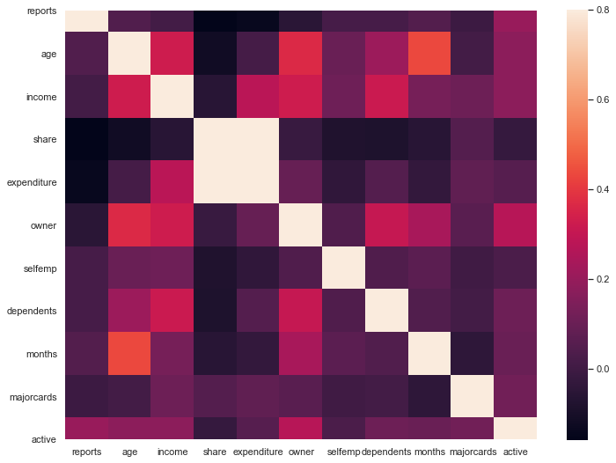

Slide 26
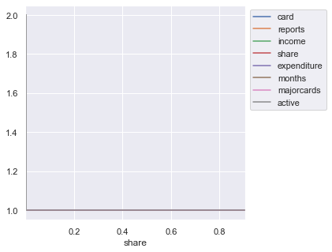

Slide 27
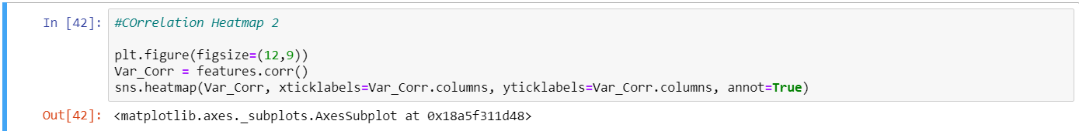
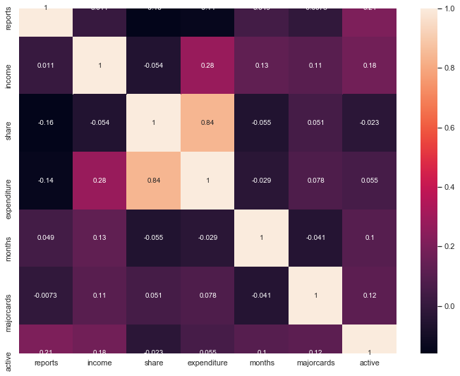

Slide 28
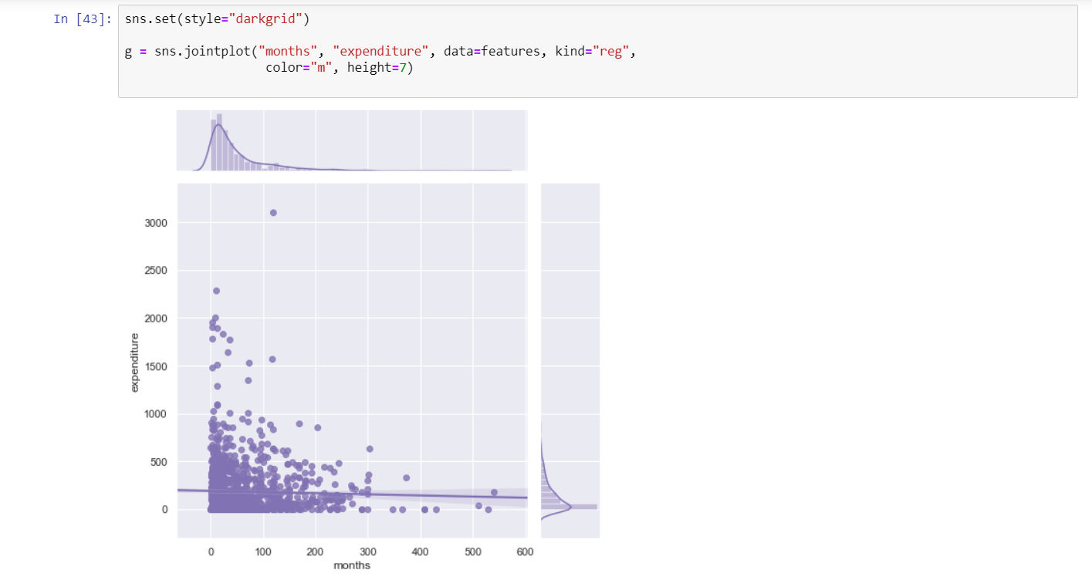

Slide 29
